Slide 1

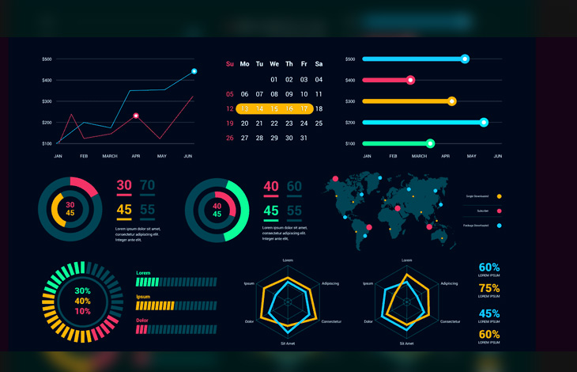



2 048 × 2 048
ETL 5 :
Visualisation
Laura Belmond - Solution Engineer

Slide 2
Deliverables session 5 :
2 streamline dashboards :
-powerpoint with screenshot of the two dashboard
-2 python files for the streamline code

Slide 3
TABLE
OF CONTENT
Key takeaways from this class
Why visualisation is the key ?
My top 3 visualization for high impact
Data quality and governance
Team work

Slide 4
Definition
Session number
1 | Lakehouse | ETL, ELT | OLAP, OLTP
2 | Key pair | IAAS, PAAS, SAAS | Role based access policy
3 | Kafka : Parallel processing | Kafka Topic | Kafka Partition
4 | Automation | Orchestration | CDC

Slide 5
Tools
Session number
1 | Snowflake | Fivetran | AWS Glue
2 | AWS S3 | Azure data factory | Google Big query
3 | Kafka | Confluent | Docker
4 | Airflow | Dagster | DBT

Slide 6
Real world
Data Engineer
Solution engineer / Solution architect
Professional Services
Data Scientist
Data Steward
Head of Architecture
Full stack engineer
Consultant

Slide 7
TABLE
OF CONTENT
Key takeaways from this class
Why visualisation is the key ?
My top 3 visualization for high impact
Data quality and governance
Team work

Slide 8
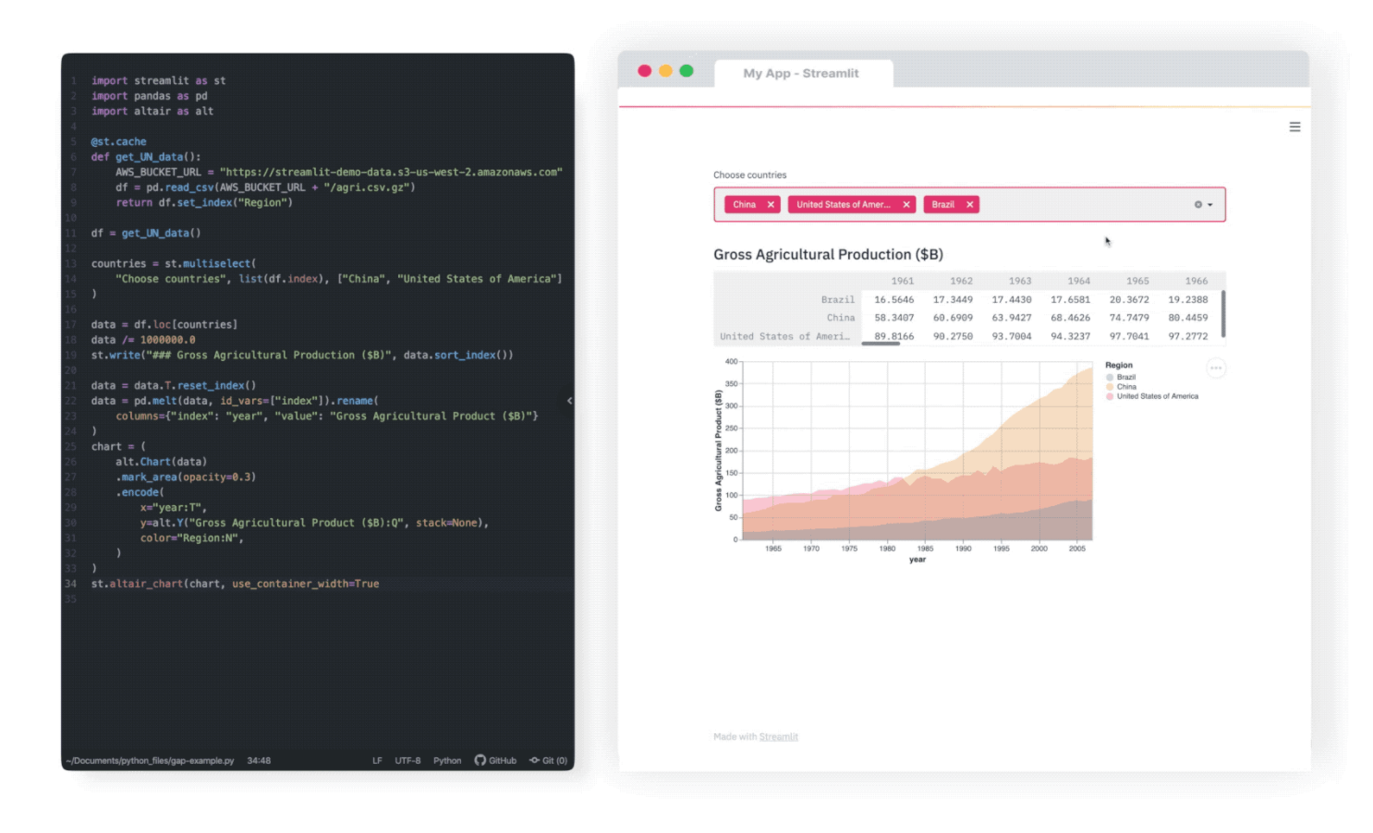
Live Demo

Slide 9
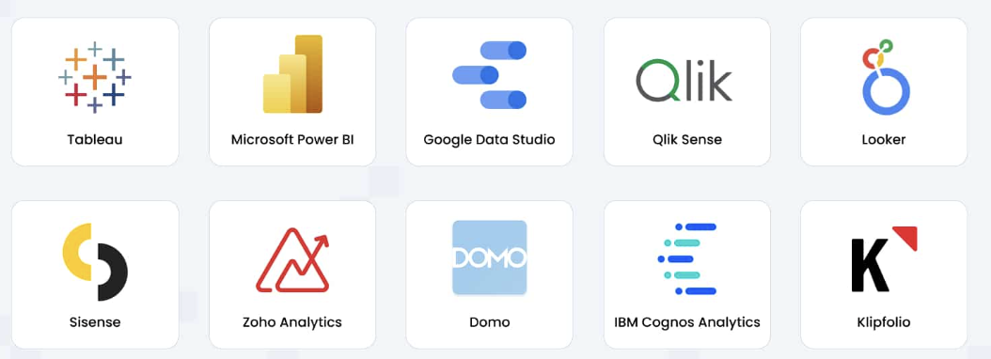
Tools

Slide 10
TABLE
OF CONTENT
Key takeaways from this class
Why visualisation is the key ?
My top 3 visualization for high impact
Data quality and governance
Team work

Slide 11
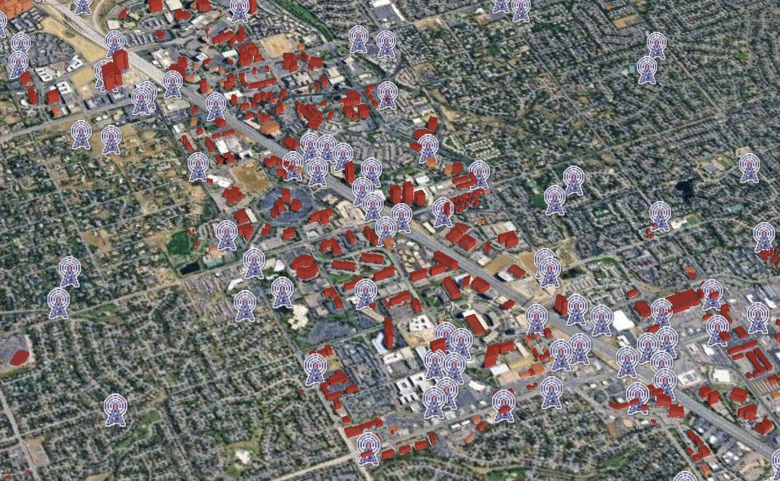
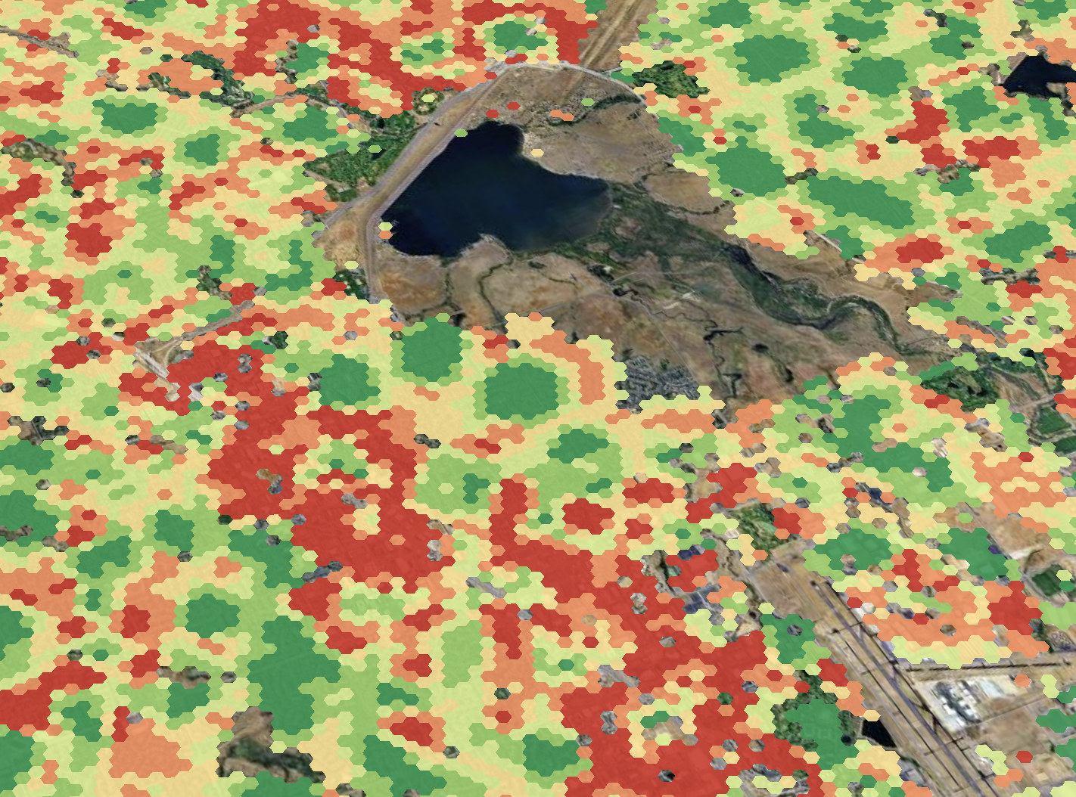
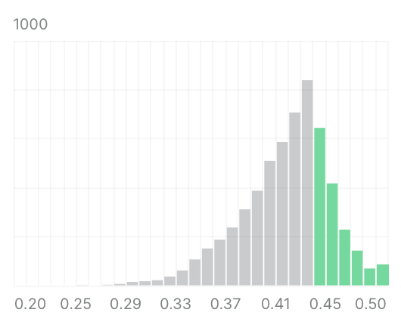
Top 1 : Map / Geospatial data

Slide 12
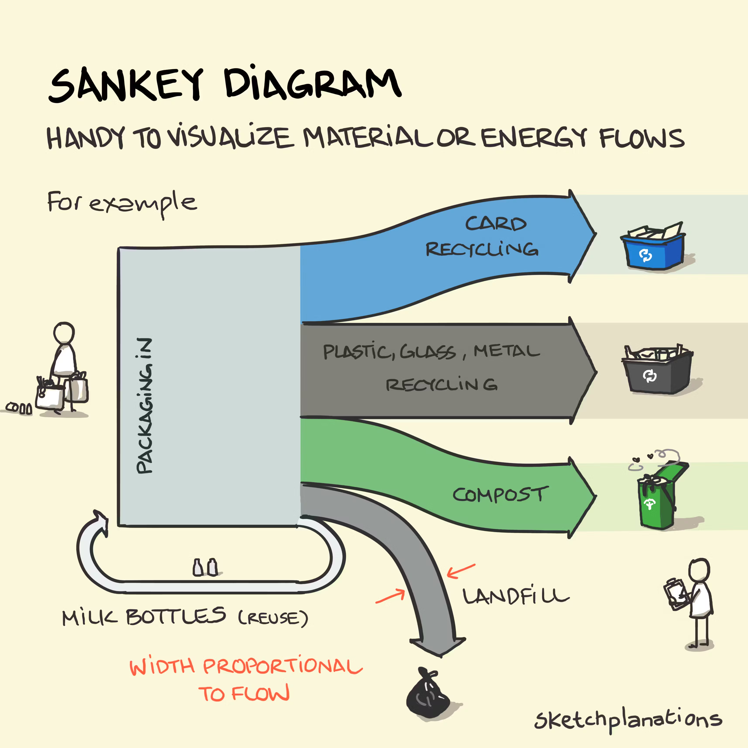
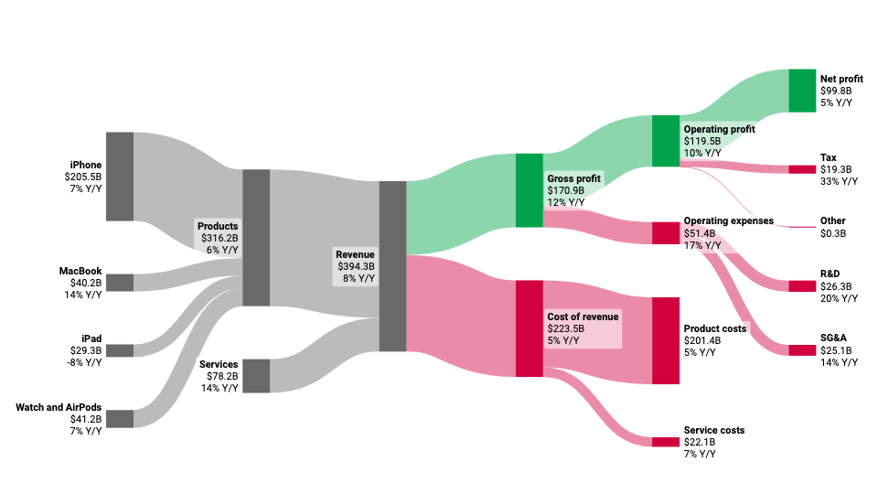
Top 2: Sankey Diagram

Slide 13
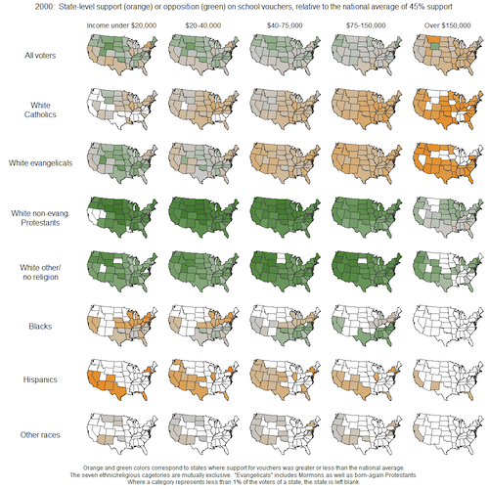
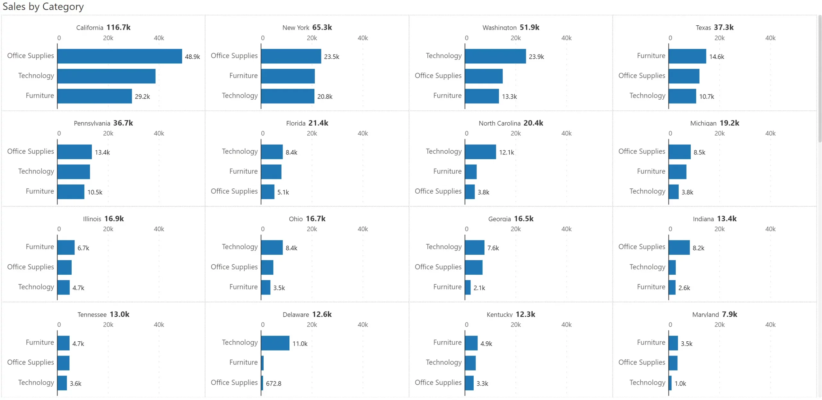
Top 3: Small multiples

Slide 14
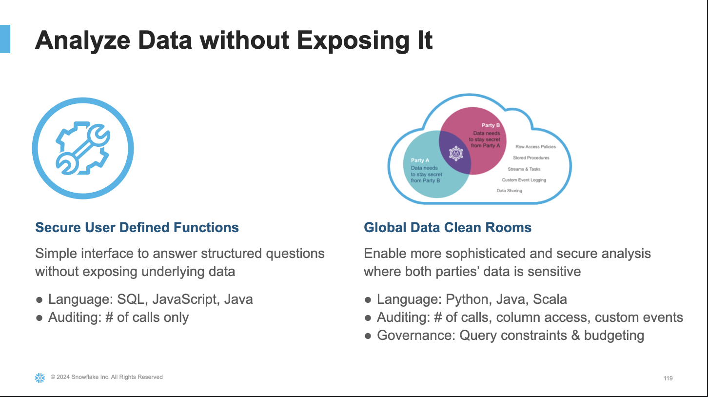
Trend of the market : Data Clean Room

Slide 15
TABLE
OF CONTENT
Key takeaways from this class
Why visualisation is the key ?
My top 3 visualization for high impact
Data quality and governance
Team work

Slide 16
Two main orientation to check ‘data quality’
Operation
Governance

Slide 17
Operational Dashboard
Type 1: Operational Dashboard (For the DataOps Team)
This dashboard is focused on the system's health and immediate pipeline stability. It is used by Data Engineers, DataOps, and administrators to detect and fix problems instantly.
Audience: Data Engineers, Technical Leads, DevOps.
Core Question: Is the pipeline working correctly and efficiently?
Example of KPI
Job Success Rate: Percentage of successfully completed tasks over the last 24 hours.
Active Failures: A live counter of critical errors (e.g., "Ingestion job failed on primary table »). Maybe with alerts
Mean Time to Recovery (MTTR): The average time it takes for an engineer to resolve a failed pipeline step.
Timeliness & Freshness: refresh KPI
Pipeline Latency: Time elapsed between data creation at the source and its availability in the final analytical table (often measured in minutes).
Data Ingested Volume: The total number of rows or gigabytes loaded per day (used to detect if a source system has stopped sending data).
Average Run Time: The time taken by key transformation jobs (e.g., "Monthly Aggregation took 45 minutes").

Slide 18
Governance Dashboard
Type 2: Governance Dashboard
This dashboard focuses on the intrinsic quality of the data itself. It measures trust and compliance, which is essential for C-suite and regulatory purposes.
Audience: Data Owners, Business Analysts, Compliance Officers.
Core Question: Can I trust this data for my financial reporting?
Example of KPI
Completeness: Measures how much data is missing. (Like the percentage of rows where essential columns (like customer_id or revenue_amount) are NULL or blank.)
Validity: Ensures data adheres to defined format rules and constraints. (like Flagging instances where a date field contains a future date, an invalid entry).
Uniqueness: Guarantees no core records are duplicated.
Consistency: Verifies that data is synchronized and logical across different tables or systems. A good data mapping or data lineage can be part of this
Accuracy: Measures how well the data reflects the real-world truth.
Grant and access : who can see what in the dashboard

Slide 19
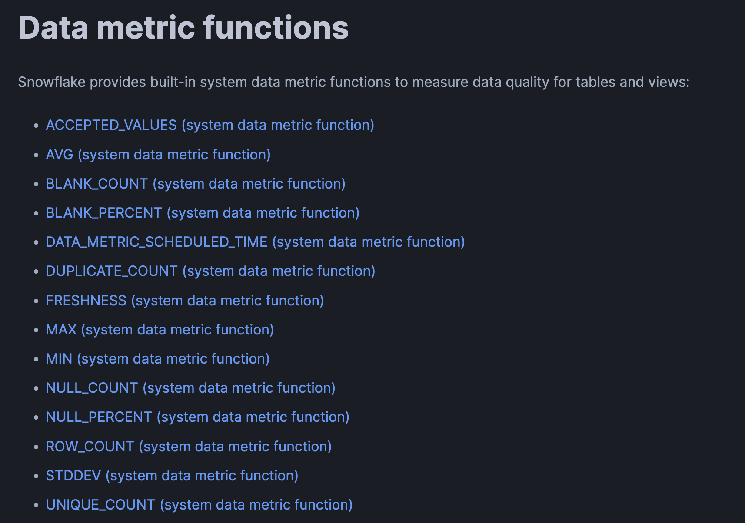
Know the quality of your data

Slide 20
TABLE
OF CONTENT
Key takeaways from this class
Why visualisation is the key ?
My top 3 visualization for high impact
Data quality and governance
Team work

Slide 21
3rd query challenge
There are 3 queries to solve (without chatGPT). These queries are inspired by my real interviews at
Google, Amazon & Snowflake.
The purpose is to have an approximate answer quite fast & to understand the logic.

Slide 22
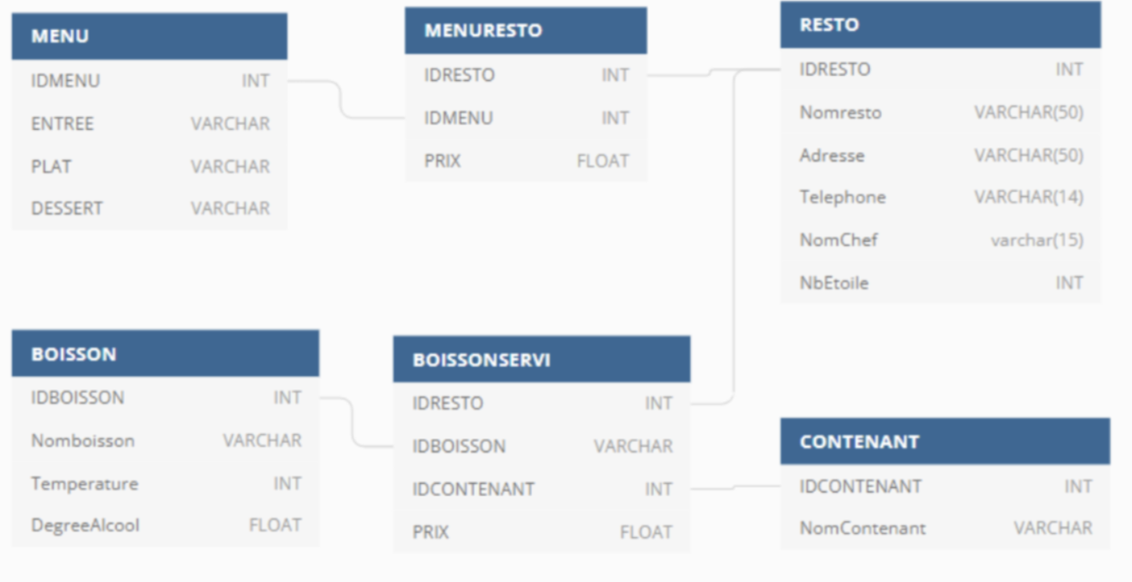
3rd query challenge
For each restaurant give the name of the restaurant, the name of the chef, the number of stars, the min the max and the average price of the menu

